Slide 1
VISUALIZING KEEZHADI EXCAVATION OBJECTS IN AUGMENTED REALITY
Name : Dhivagar V
Roll no : 2019272008
Degree : 3rd Year MCA (SS)
Project Guide: Mr.J. Duraimurugan

Slide 2
ABSTRACT:
Augmented reality (AR) is an enhanced version of the real physical world that is achieved through the use of digital visual elements, sound and delivered via technology.
Now using this AR technology, we are going to create the artefacts into a virtual object.
For example, In Keezhadi excavation site various Artefacts are found like urns, various types of pottery (red utensils, black objects), iron tools, knives, swords and arrows, some stone beads and some gold ornaments. By this project we turn many valuable and damaged antiques into 3D models by using AR.

Slide 3
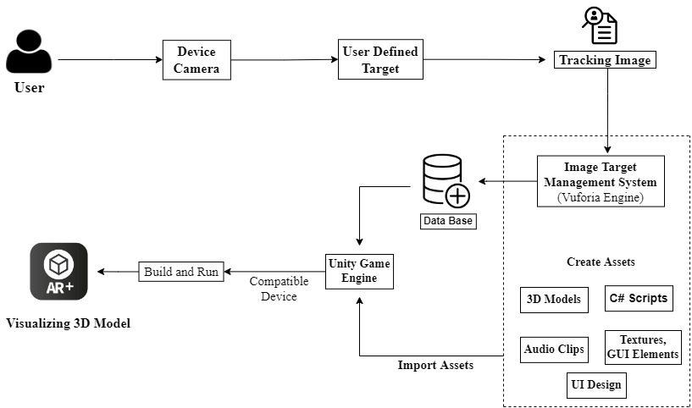
DESIGN AND ARCHITECTURE
First review
2nd review

Slide 4
List of the MODULES:
Rendering 3D Object:
The primary use of Blender is to create three-dimensional objects and scenes using the 3D viewport and a suite of modeling tools that allow the user to create any object and any scenario that they want to create in 3D space.
Basic objects and environments can be created using mesh objects constructed from three types of geometry. These are vertices, edges, and faces.
There were two rendering module teams in Blender: Cycles, Eevee.

Slide 5
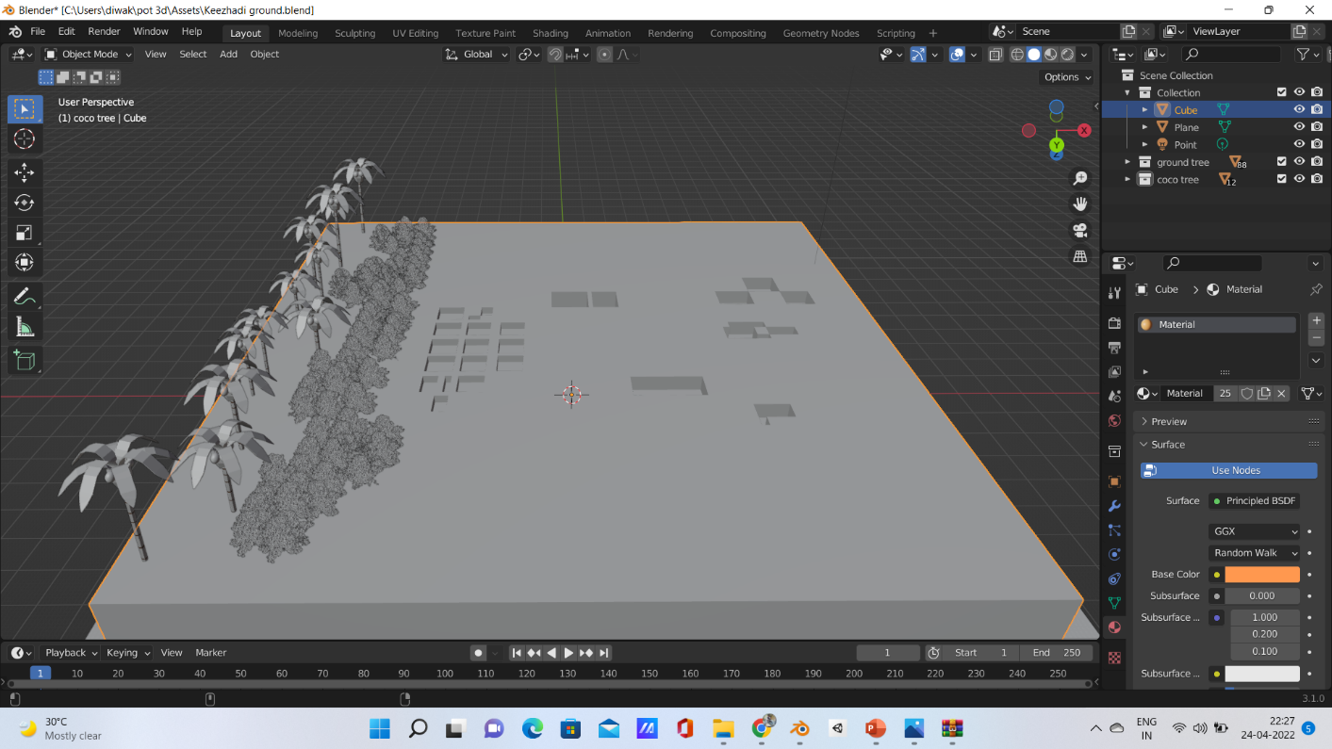
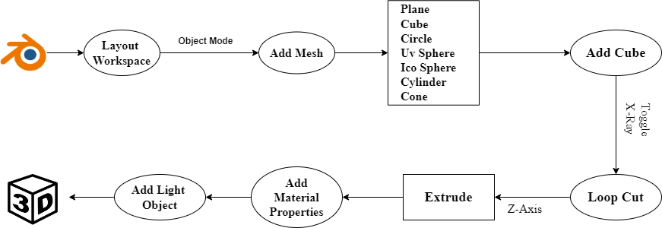
Keezhadi Ground View 3D Model:

Slide 6
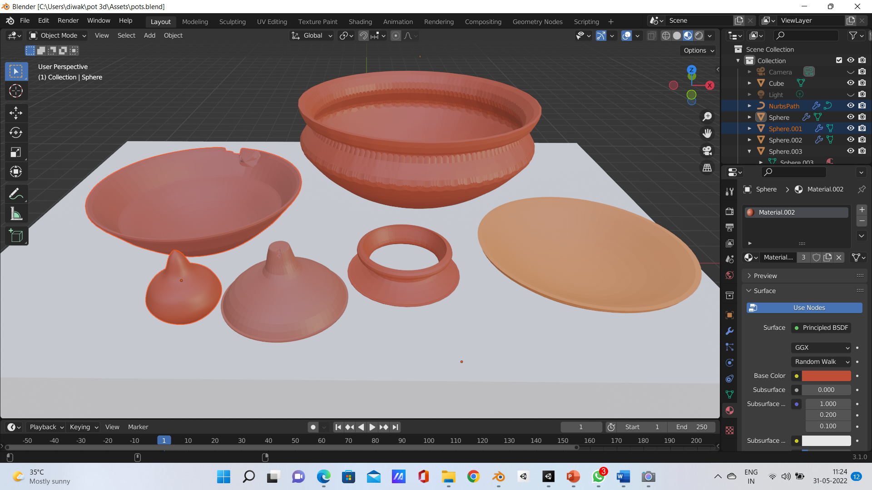
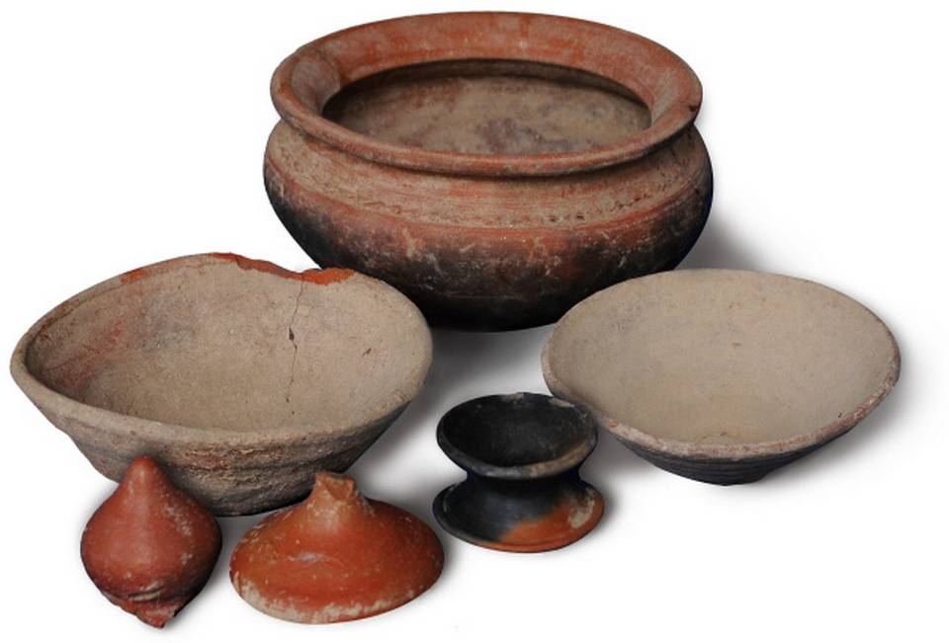
Original 2D Image
3D Model

Slide 7
IMAGE PROCESSING MODULE:
AR Camera & Image Target:
Vuforia for this project we decided to go with Vuforia SDK in order to enable AR instead of unity’s own AR.
The Engine detects and tracks the image by comparing extracted natural features from the camera image against a known target resource database. Once the Image Target is detected, Vuforia Engine will track the image and augment your content seamlessly using best in market image tracking technology.

Slide 8
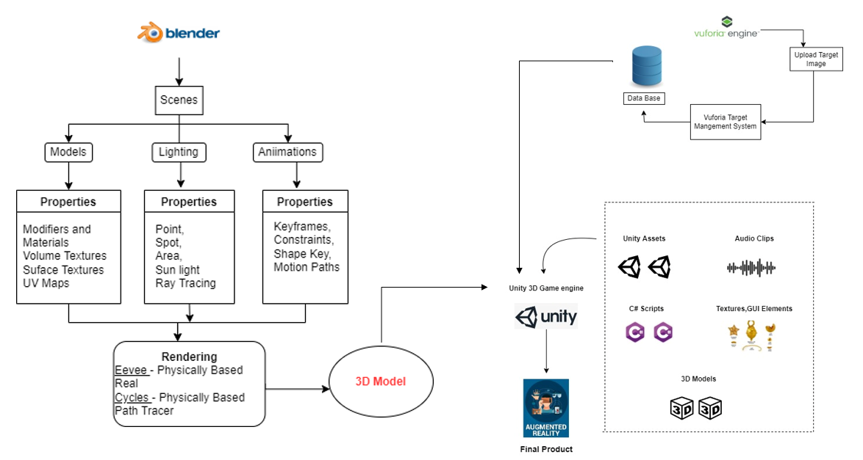
MODULES DESIGN AND DEVELOPMENT PROCESS:

Slide 9
VISUALIZING OBJECT:
The development process begins by exporting a building model from Blender. The model should have a low polygon count for use in a gaming engine and for AR. Therefore, some parts of the model will need to be reduced in complexity. Remodeling, collapsing and adding animations to the model are done in Unity.
After the successful download and installation, create your project in Unity3D.

Slide 10
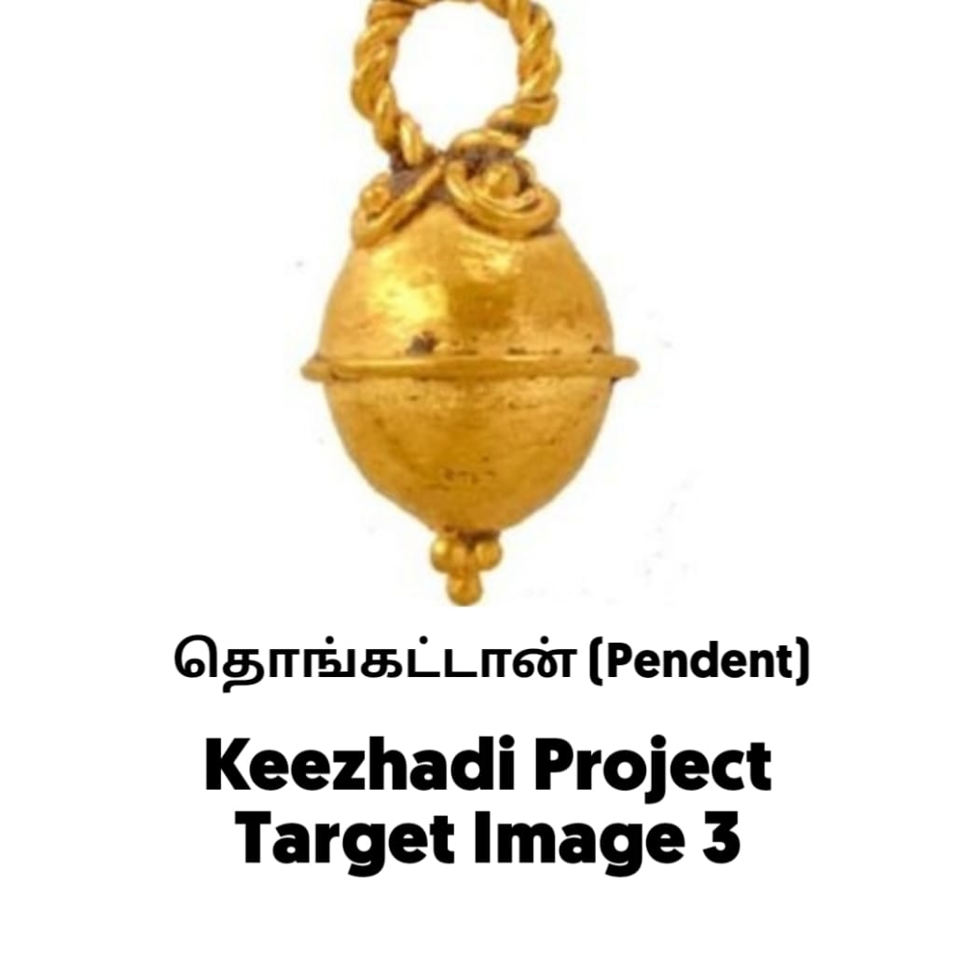
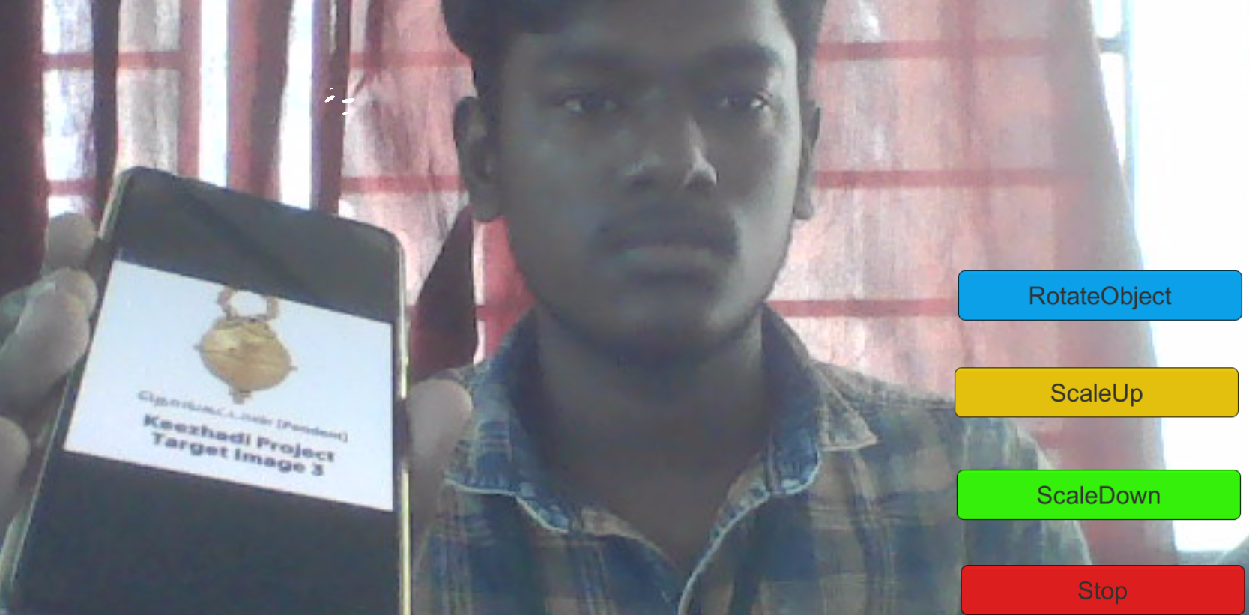
IMPLEMENTATION :
Target Image
Track the 2D image in AR Camera

Slide 11
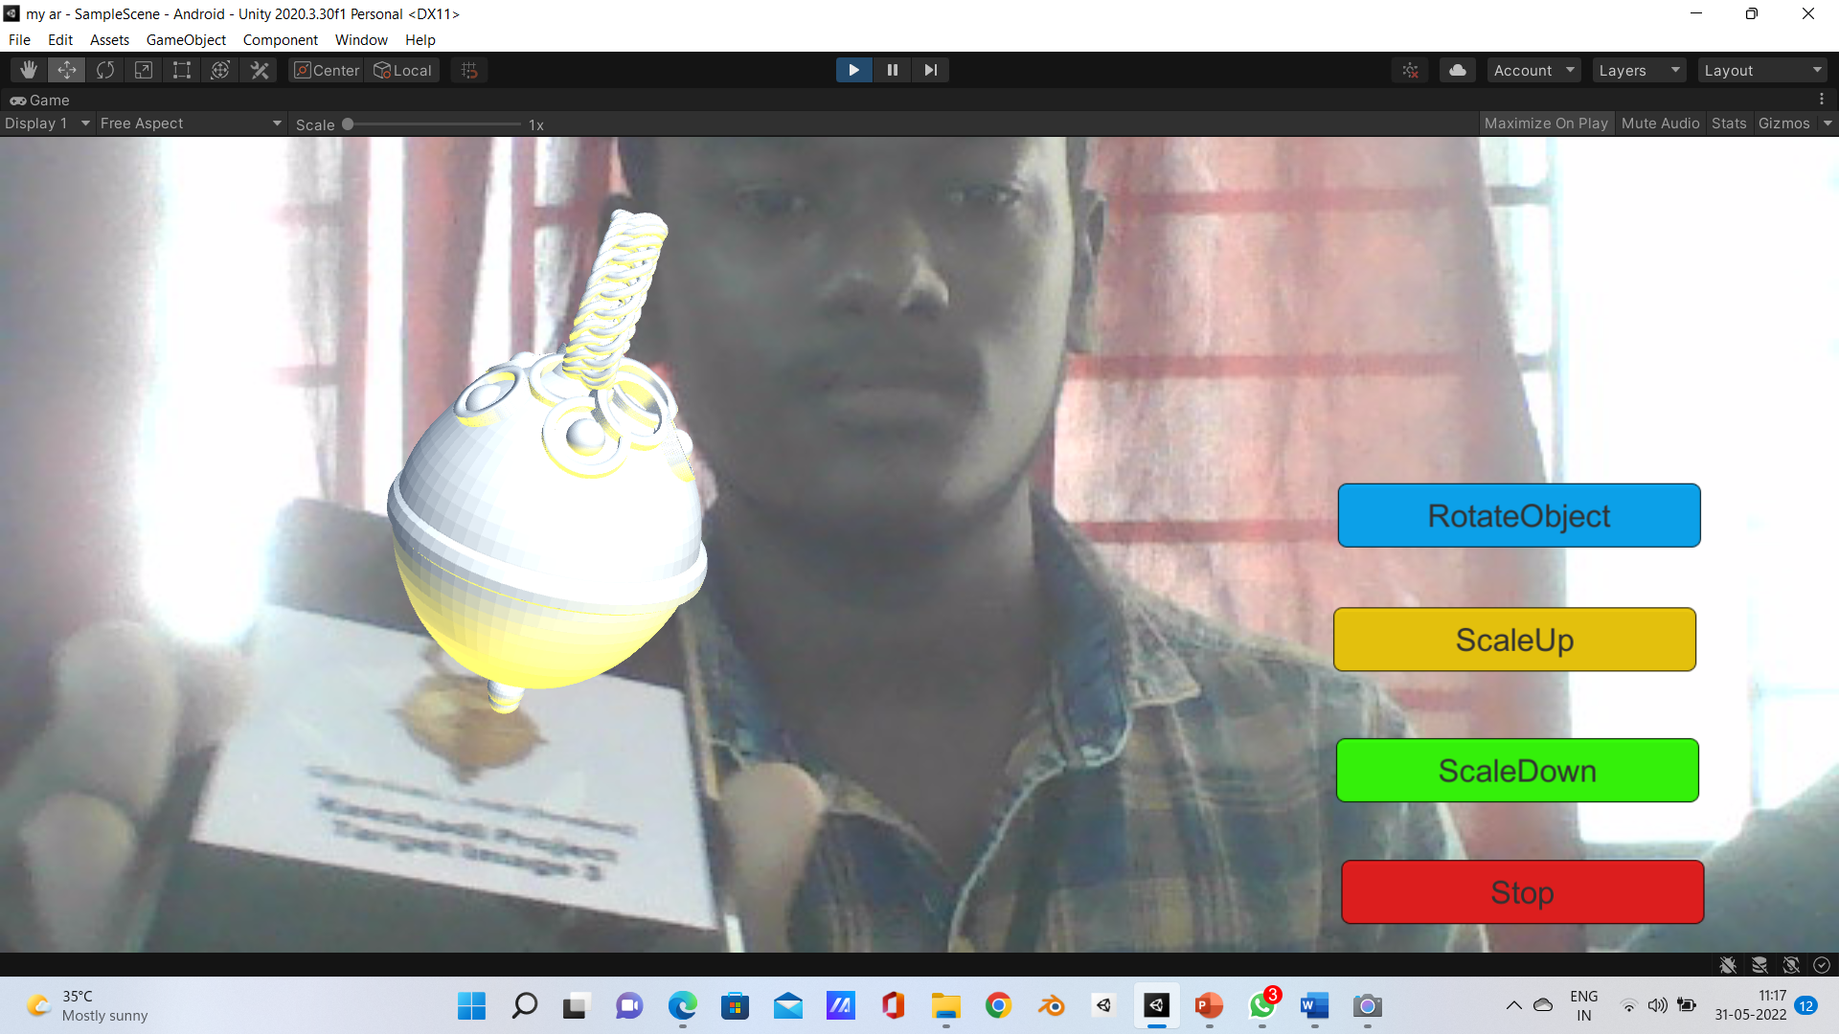
Object Displayed in AR Camera

Slide 12
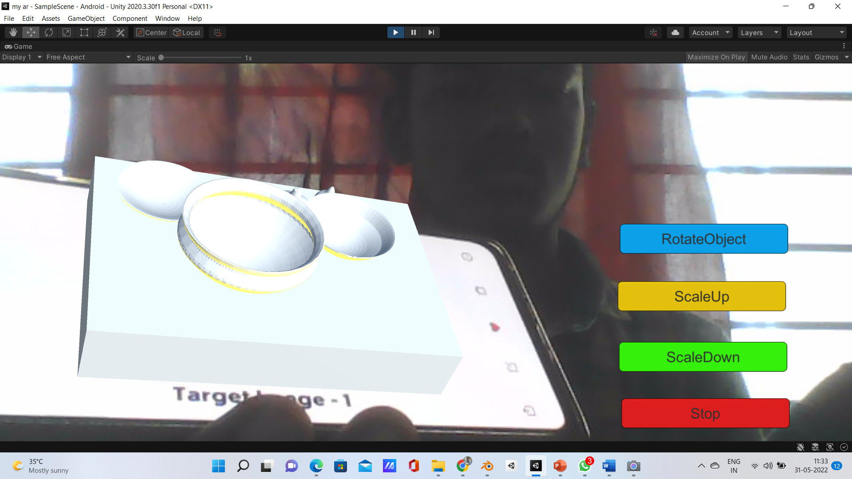
Rotate Object:

Slide 13
REFERENCES:
Rascar R., G. Welch and H. Fuchs, 1998, Spatially Augmented Reality, First International Workshop on Augmented Reality, 1st November, San Francisco, USA, 7p.
Rolland, J.P. L.D. Davis, and Y. Baillot, 2001, A Survey of Tracking Technologies for Virtual Environments, Fundamentals of Wearable Computers and Augmented Reality, W. Bar.eld and T. Caudell, eds, Lawrence Erlbaum
https://www.udemy.com/course/learn-blender-3d-modeling-for-unity-video-game-development/
https://unity.com/how-to/beginner/using-blender-and-maya-unity
https://www.raywenderlich.com/31539225-creating-reusable-characters-with-blender-and-unity
https://gamedevacademy.org/how-to-import-blender-models-into-unity-your-one-stop-guide/

